Slide 1
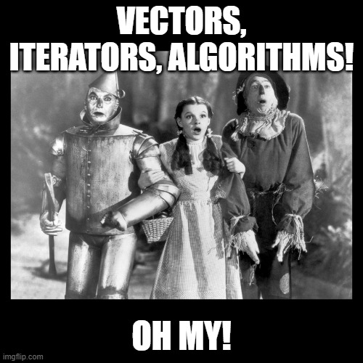
Week 3, Day 2
Yer 1st STL “container”: vector
vectors!
iterators!
algorithms!
Oh my!!!

